Slide 1
CENG 407 lıcence plate recognıtıon system Project presentatıon
TEAM MEMBERS
Mehmet Furkan turan
Arda kayış
Doğukan tutak
Burak çetin
Muhammed emin atalık
Advısor
Prof. Dr. Ahmet coşar

Slide 2
CONTENTS
Problem
Analysis - Methods of Licence Plate Recognition System
Similar Projects
Solution
Technology Used
Working Principle of the System
Diagrams
Work Plan
Results and Conclusion

Slide 3
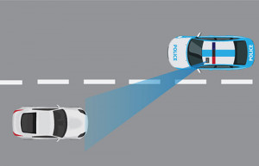
PrOBLEM
Police forces
Military areas
Traffic control
Keeping city entrances and exits under control
City security
Establishment of smart traffic systems

Slide 4
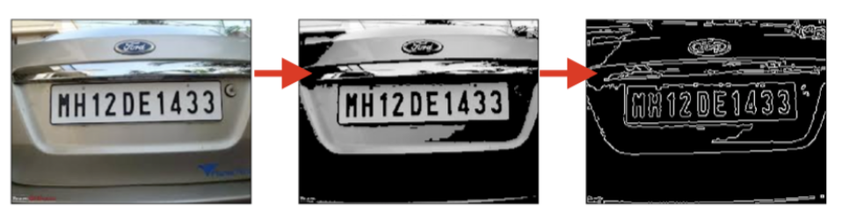
Analysıs – Methods of Lıcence Plate Recognıtıon System
Licence Plate Detection
Edge Based Methods
Colour - Based Methods
Texture Based Techniques
Character-Based Methods
Deep-Learning Techniques

Slide 5

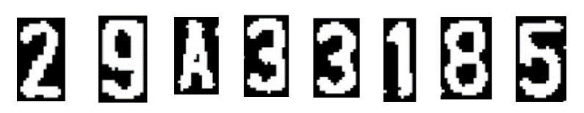
Analysıs – Methods of Lıcence Plate Recognıtıon System
Licence Plate Recognition
Pre-processing Techniques
Character Segmentation
Character Recognition

Slide 6



SIMILAR PROJECTS
ArmaKontrol
AXIS COMMUNICATIONS
NEUTRON

Slide 7
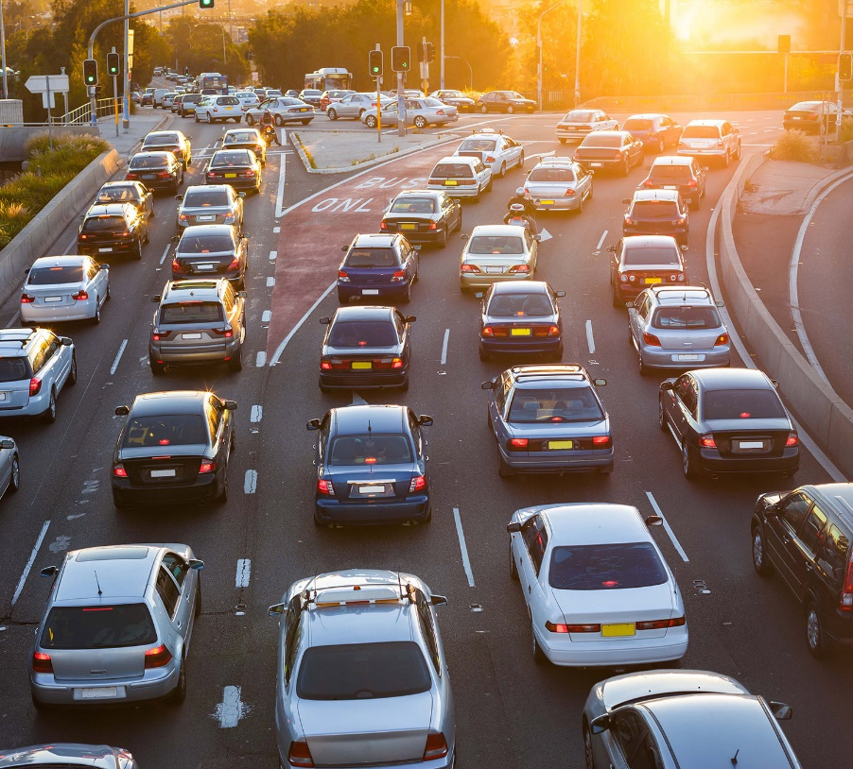
SOLUTION
License Plate Recognition System offers a solution that has been needed in recent years and necessary steps can be taken for the operation of an efficient smart transportation network.

Slide 8
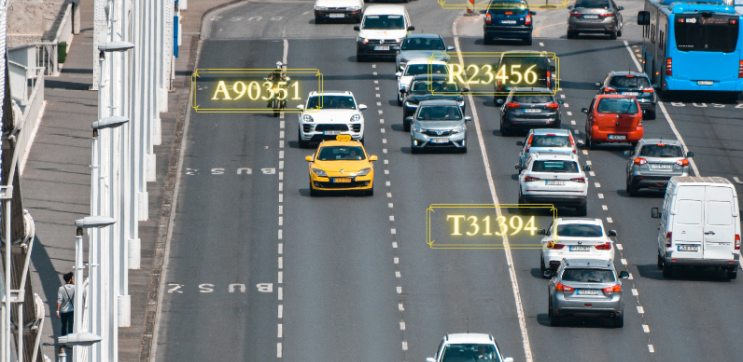
SOLUTION
The model consists of three modules: vehicle detection module, license plate segmentation module and recognition module. In the License Plate Recognition System project, it is aimed to detect the license plates of the vehicles by using image processing and deep learning methods and to ensure that the license plates are read.

Slide 9




Technology Used
Python
TensorFlow – The library for deep learning training
OpenCV - The libray for license plate detection and character segmentation
Keras - Open source neural network library written in Python.

Slide 10
WORKING PRINCIPLE OF LICENCE PLATE RECOGNITION SYSTEM
Finding all the contours in the picture.
Compare and verify the side ratio and area of each bounding rectangle.
Image segmentation
Characters on the plate are recognized by using OCR.
Training phase by using the deep learning.

Slide 11
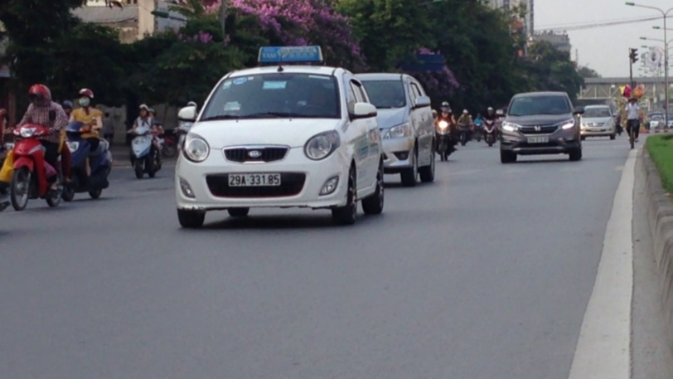
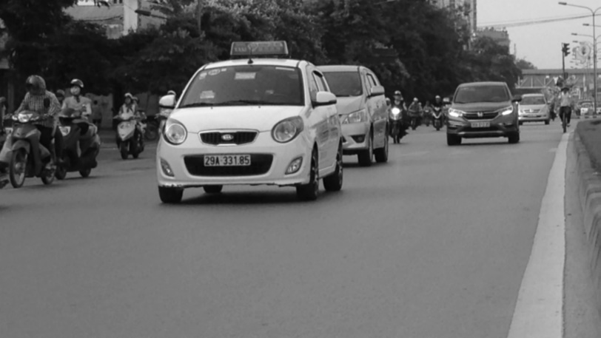
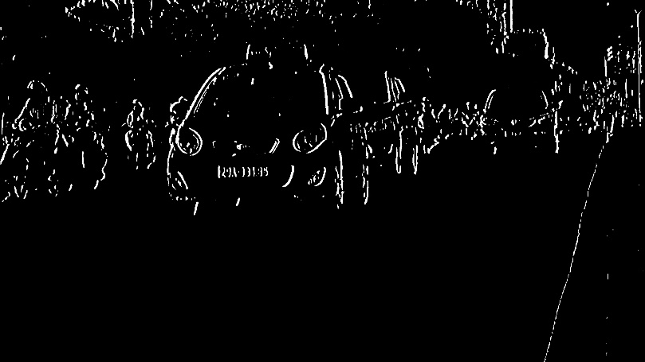
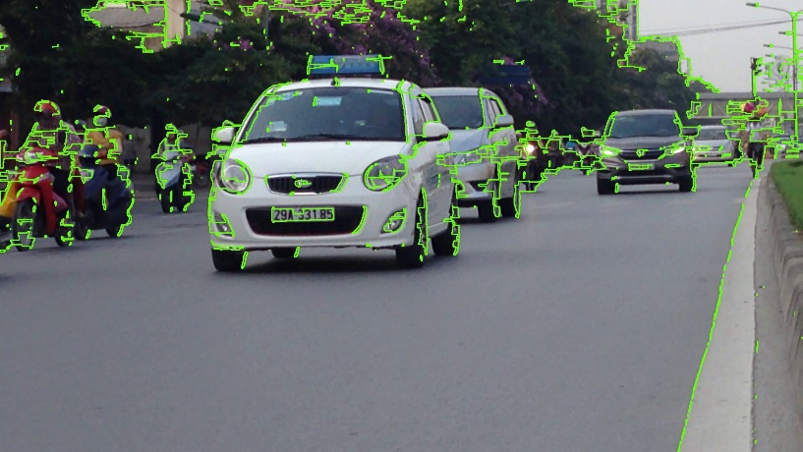


Slide 12
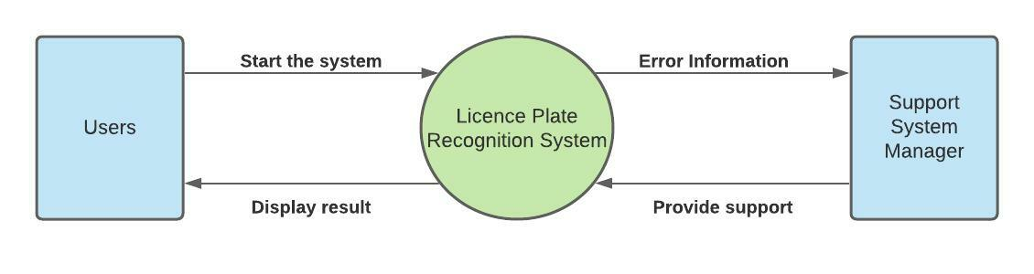
DATA FLOW DIAGRAM - LEVEL 0

Slide 13
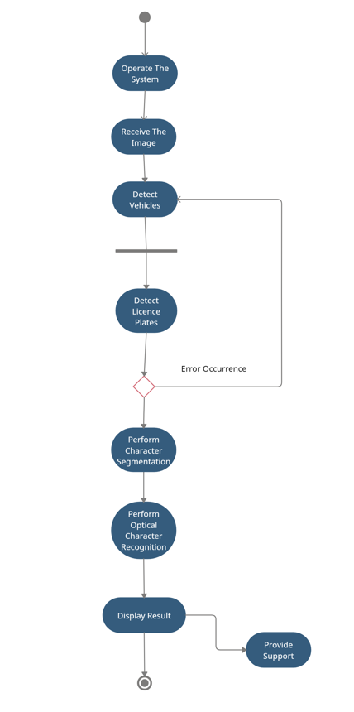
ACTIVITY DIAGRAM

Slide 14
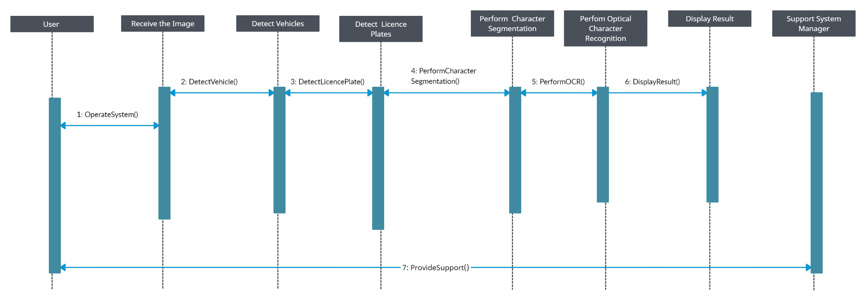
SEQUENCE DIAGRAM

Slide 15
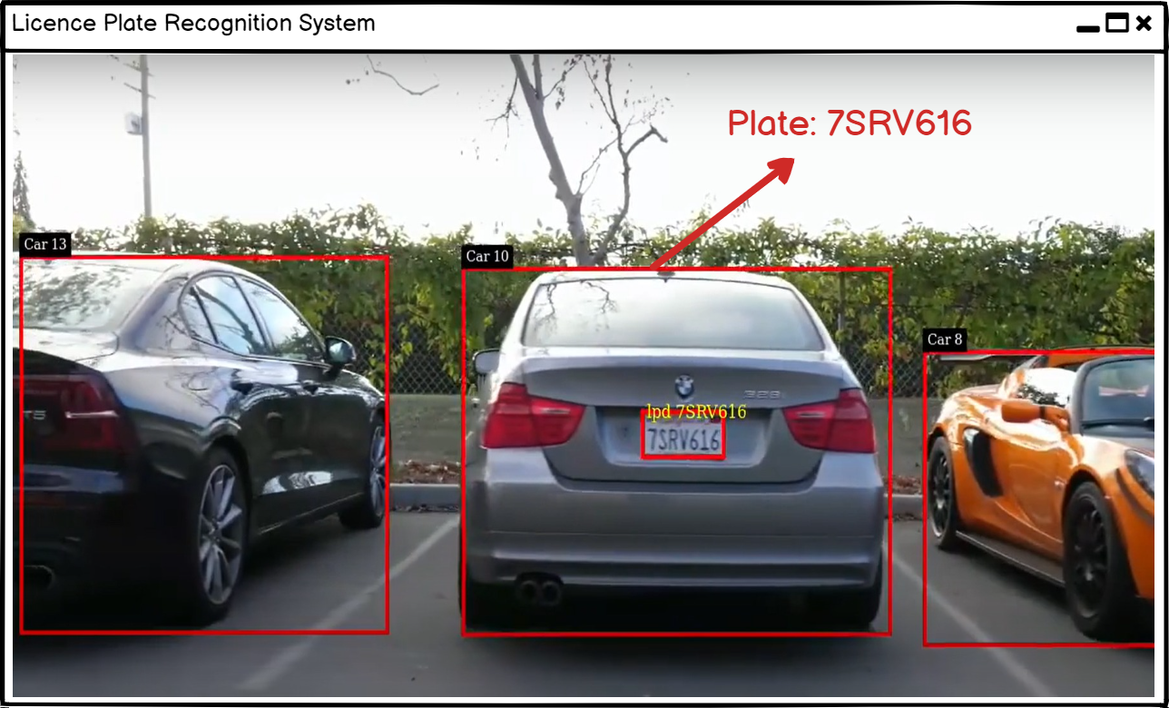
USER INTERFACE

Slide 16
Work plan

Slide 17
conclusıon
It is aimed to determine the features required for the recognition of license plates by using image processing, image detection and recognition methods for the License Plate Recognition System by using the deep learning method with libraries such as TensorFlow and Keras.

Slide 18

THANK YOU FOR LISTENING

